Slide 1
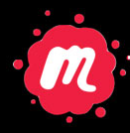
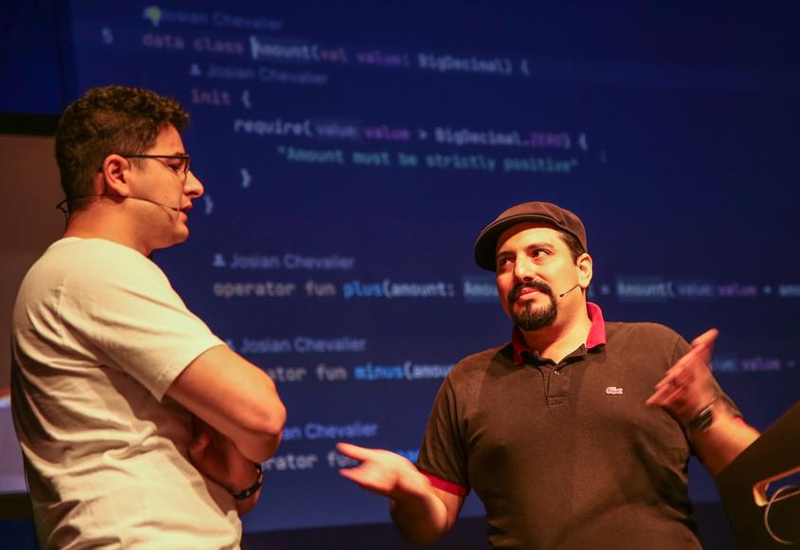

Model mitosis
A dynamic pattern to deal with model tensions
#DDDFR
Josian Chevalier
Julien Topçu
Shodo
Tuesday October 17th 2023 19h15
1 Rue de Saint-Pétersbourg 75008 Paris

